Slide 1
Pump It Up !
Group-7 :
Prem Krishn
Tapas Ray
Kaustubh Daware
Sasank Amavarapu

Slide 2

Water
Water
Covers nearly 71% of earth
96.5% of water in seas and oceans
Less than 0.3% of all freshwater in rivers, lakes and the atmosphere
Greater quantity of water found in the earth's interior.
Borewell , water pump and well general method of extraction
Getting rarer commodity day by day

Slide 3
Water
Another problem in getting water: non functional water points
Need regular maintenance of water points
If we can predict which are likely to be dysfunctional water points,
We can prioritize them first and repair to functional state
Contribution to the society
Can be reapplied in other places too

Slide 4
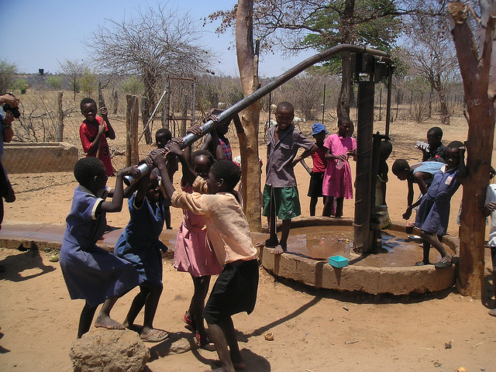
PUMP IT UP

Slide 5
PUMP IT UP
Competition hosted by drivendata.org along with Tanzanian Ministry Of Water
Problem statement : Given a train data of many pumps in Tanzania with number of variables
For example,
What kind of pump is operating,
When it was installed
How it is managed
Predict which pumps in test data are functional, which need some repairs, and which don't work at all This is an intermediate-level practice competition.
A smart understanding of which waterpoints will fail can improve maintenance operations and ensure that clean, potable water is available to communities across Tanzania

Slide 6
PUMP IT UP: DATA
Comprises of nearly 40 variables, mostly categorical, few numeric
Few are water point location description variables such as longitude latitude, region, region code, district, local government authority, sub village.
Others explain what type of water pump used, water quality, project funder, and management team.

Slide 7
DATA CLEANING
Problem: Few features with too many levels.
Example: subvillage: 19287 levels
Remedy : Remove
Problem: Some feature doesn’t bear any significance as per domain knowledge.
Example: Water point name
Remedy: Remove
Problem : Also, variables with same info are repeated. Doesn’t add any new information
Example: Region and region code
Remedy: Keep any one.

Slide 8
DATA CLEANING
Problem: Few variables with many classes are later merged into fewer levels and defined as new variable.
Remedy : Variable with more classes is retained as it contains maximum info
Extraction_type
18 Levels
Extraction_type_group
13 Levels
Extraction_type_class
7 levels

Slide 9
DATA CLEANING
Time for which water point operational might crucial determining current functional status of water point
( as it gets older, more probable to need repairs)
Dataset gives date when water point started operating and when observation taken
Difference between them can give operational time
Two new features constructed
Number of days
Number of months since water point is operational

Slide 10
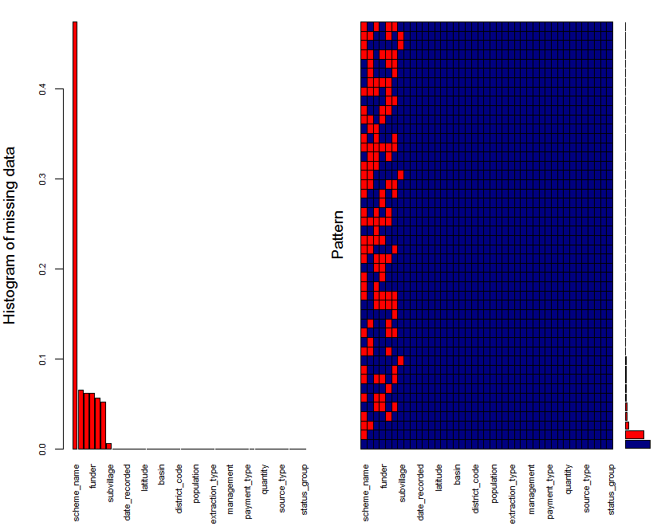

Slide 11
Exploratory Data Analysis & Data Preparation Labels
Our labels are under the column "status_group" and are one of the three following values:
functional - the waterpoint is operational and there are no repairs needed
functional needs repair - the waterpoint is operational, but needs repairs
non functional - the waterpoint is not operational

Slide 12
Categorical Features
We have the following categorical variables:
funder - Who funded the well
installer - Organization that installed the well
basin - Geographic water basin
subvillage - Geographic location
region - Geographic location
public_meeting (T/F)
permit (T/F) - If the waterpoint is permitted
scheme_management - Who operates the waterpoint
permit (T/F)
extraction_type - The kind of extraction the waterpoint uses
extraction_type_group - The kind of extraction the waterpoint uses
extraction_type_class - The kind of extraction the waterpoint uses
management - How the waterpoint is managed
management_group - How the waterpoint is managed
payment - What the water costs
payment_type - What the water costs
water_quality - The quality of the water
quality_group - The quality of the water
waterpoint_type - The kind of waterpoint
waterpoint_type_group - The kind of waterpoint
source - The source of the water
source_type - The source of the water
source_class - The source of the water
quantity - The quantity of water (dry, enough, insufficient, seasonal, unknown)

Slide 13
Continuous Features
We have four quantitative features:
amount_tsh - Total static head (amount of water available to waterpoint)
gps_height - Altitude of the well
population - Population around the well
date_recorded_offset_days
In each of our models, we must consider how to best use the categorical features--in fact, after EDA we eventually decided that our preferred approach was to convert the categorical feature into indicator variables, to be seen in df_formatted.
Notes:
Note that we also have access to the well's latitude and longitude, which we use in the visualizations. However, as they are unique for each well, we drop both features in our dataframe used to build our models.

Slide 14
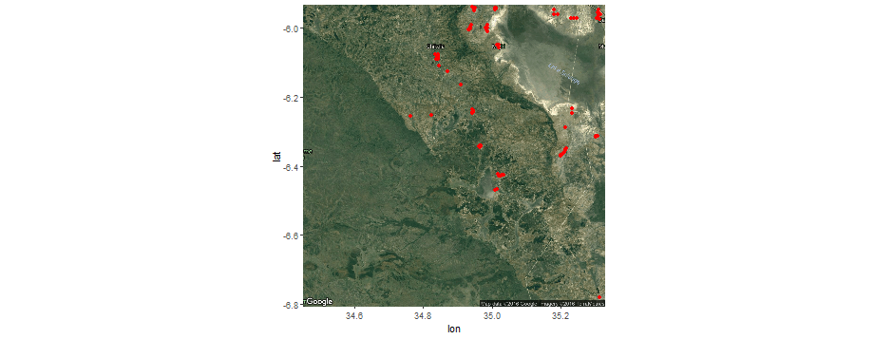

Slide 15
Redundancies
We inspect the unique values of each of these columns. We find that some of the columns describe the same feature but have slightly different sets of values.
Particularly the case with features that have a corresponding ' _group' column as well. Although the non-group features are more specific, we chose to use the grouped features as we quickly found that attempting to split up an even larger number of features into indicator variables was computationally and time-intensive.
Notes:
Ideally, if we had even more time and faster processing speeds, we would love to further explore the more specific feature set.

Slide 16
Summary of Nested Features
In df_new, we know that:
management is nested within management_group
source is nested within source_class
extraction is nested within extraction_type_class
subvillage has too many levels.

Slide 17
Summary Groupings of Categorical Variables
The features dealing with the management of the well include:
funder
installer
scheme_management
management/management_group
payment_type
permit (T/F)
The features dealing with the creation of the well include:
extraction/extraction_type_class
waterpoint_type
The features dealing with time include:
construction_year
date_recorded_offset_days (int; how long ago it was constructed, from the date recorded)
date_recorded_month
The features dealing with natural properties include:
water_quality
source/source_class
amount_tsh
quantity

Slide 18
The features dealing with the community using the well and location include:
subvillage
region
population
public_meeting (T/F)
gps_height
longitude
latitude
Notes:
Since we were unable to identify an obvious relationship between funder and well status, we take a look at that. We are also interested in learning about the time span of when our information was collected.

Slide 19
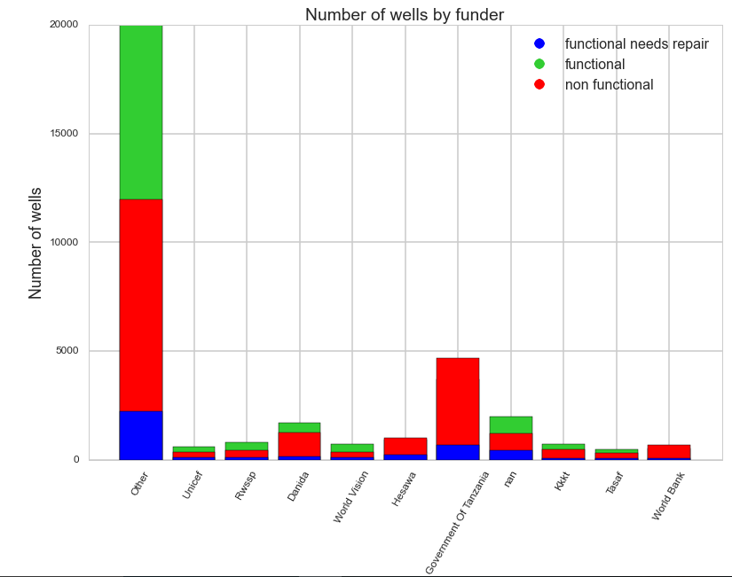
We see that there is definitely a difference in the distribution of wells across the various funders. For instance, more wells funded by UNICEF or Danida are functional than those funded by the World Bank or the Government of Danida.

Slide 20
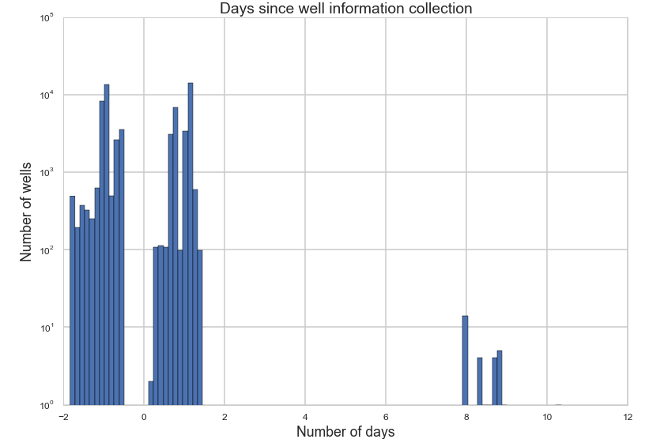
We see that the recording of the well data came approximately in two different waves, with a small group happening much later.

Slide 21
Splitting the Data into a Training and Test Set
Standardize
Now standardize our quantitative variables so they can be compared. To reiterate, these variables are amount_tsh, gps_height, population, and date_recorded_offset_days.
After standardizing we checked if they are useful indicators for well status.

Slide 22
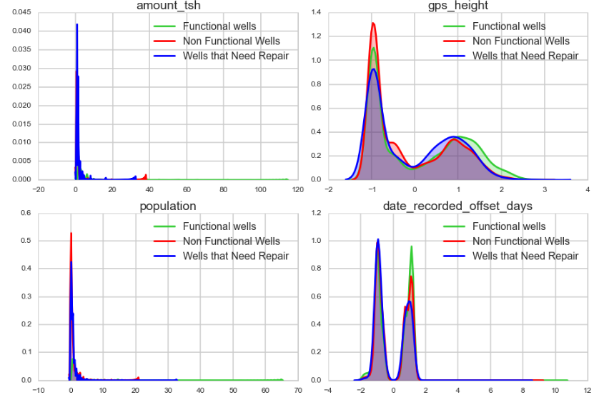

Slide 23
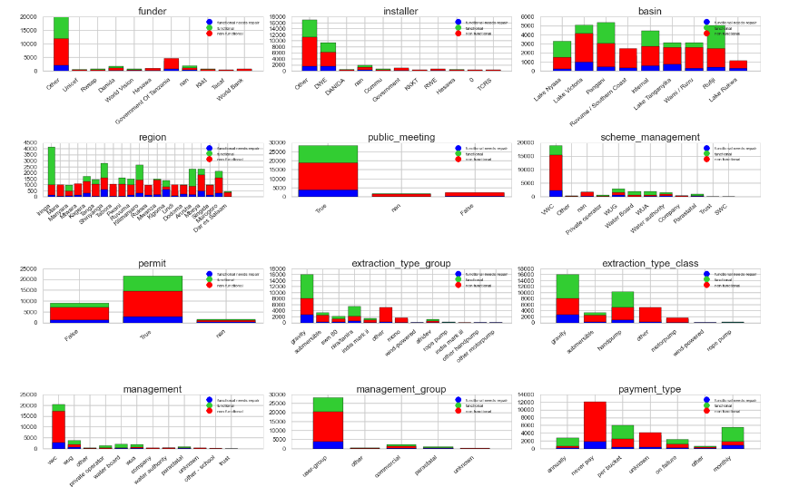
We do the same for the categorical variables

Slide 24
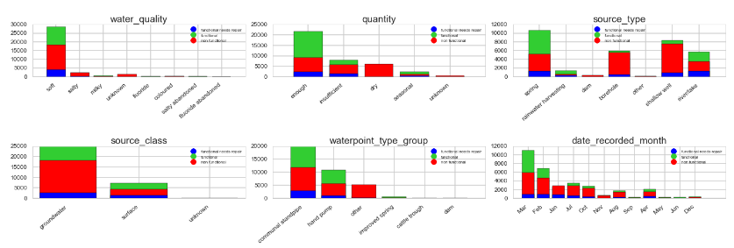

Slide 25
Observations
From our precursory exploration of the quantitative variables, we make a few observations:
Functional wells : more total static head (the water available to the water point)
Distribution of GPS height bimodal across all well statuses
Larger populations: higher probability of functionality
The amount of time since recording bimodal suggests that the reporting happened approximately two waves.
Likewise, from our categorical variables, we note the following:
Almost all wells funded by the Government of Tanzania non-functional or needed repair at the time of reporting
Iringa, Arusha, and Kilimanjaro have a higher proportion of functional wells.
The extraction type group and extraction type class might be very predictive because we see varying proportions of functionality across groups. For example, for extraction type class gravity and handpump have a much higher proportion of functional well, as opposed to submersible and other types.
Groundwater has a greater proportion of nonfunctional wells.
Dry wells are almost always nonfunctional.

Slide 26
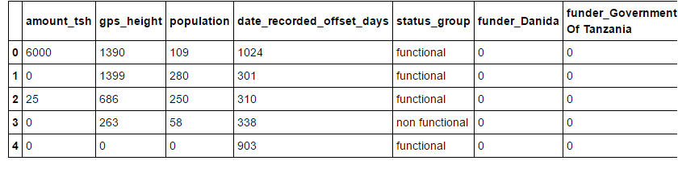
We found 19 categorical features in this data set. While we could encode these variables as ordinal numbers, our classifying algorithms expect a continuous input.
Therefore, we turn to one-of-K, or one-hot, encoding to transform each categorical feature with possible values into binary features, of which only one is active.
df_formatted = pd.get_dummies(df_new, columns=CATEGORICAL) df_formatted.head()

Slide 27
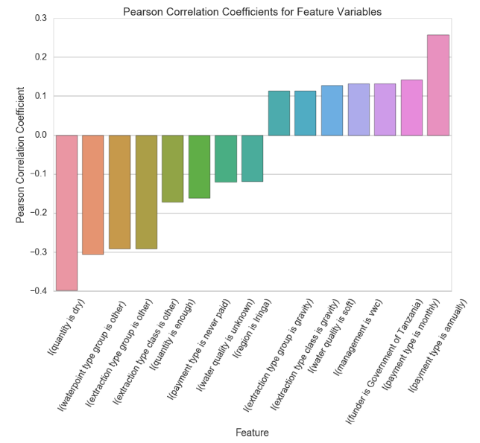

Slide 28
From Pearson’s rho correlation coefficients: quantity, water point type, and extraction type most critical
makes sense, as having a dry quantity of water might prevent a well from working, while having enough might be more correlated with a working well.
seems to be an association with "other" water point and extraction types with a non functional well.
Iringa has positive association with functional wells, whereas none of the other geographic areas show up in our list
Overall, though, note that the magnitude of any of the correlation coefficients are never above 0.3-0.4. As we might expect from a real-world problem, there is clearly not one indicator or feature that predicts well functionality, though these ones might be some of the more important ones to consider.

Slide 29
used 10-fold cross validation and evaluated algorithms using the accuracy metric, a gross metric that give a quick idea of how correct a given model is.
We decided to create a baseline of performance on this problem and spot-check a number of different algorithms. We will select a suite of different algorithms capable of working on this classification problem. The six algorithms selected include:
Linear Algorithms:
Logistic Regression (LR)
Linear Discriminant Analysis (LDA).
Nonlinear Algorithms:
Classification and Regression Trees (CART),
Support Vector Machines (SVM),
Gaussian Naive Bayes (NB)
k-Nearest Neighbours (KNN).

Slide 30
# Spot-Check Algorithms
models = []
models.append(('LR', LogisticRegression()))
models.append(('LDA', LinearDiscriminantAnalysis()))
models.append(('KNN', KNeighborsClassifier()))
models.append(('CART', DecisionTreeClassifier()))
models.append(('NB', GaussianNB()))
models.append(('SVM', SVC()))
The algorithms all use default tuning parameters. Let's compare the algorithms. We will display the mean and standard deviation of accuracy for each algorithm as we calculate it and collect the results for use later.

Slide 31
results = []
names = []
for name, model in models:
kfold = KFold(n_splits=num_folds, random_state=seed)
cv_results = cross_val_score(model, X_train, Y_train, cv=kfold, scoring=scoring)
results.append(cv_results)
names.append(name)
msg = "%s: %f (%f)" % (name, cv_results.mean(), cv_results.std())
print(msg)

Slide 32
Running the example provides the output below. The results suggest that both Logistic Regression and k-Nearest Neighbours may be worth further study.
# Compare Algorithms
fig = pyplot.figure()
fig.suptitle('Algorithm Comparison')
ax = fig.add_subplot(111)
pyplot.boxplot(results)
ax.set_xticklabels(names)
pyplot.show()

Slide 33
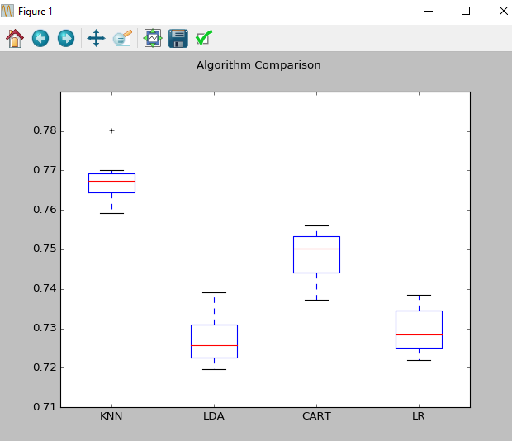
We found KNN to be the best among the algorithms for the given data .So we validate the test data using KNN and got a classification rate of 0.7628.

Slide 34
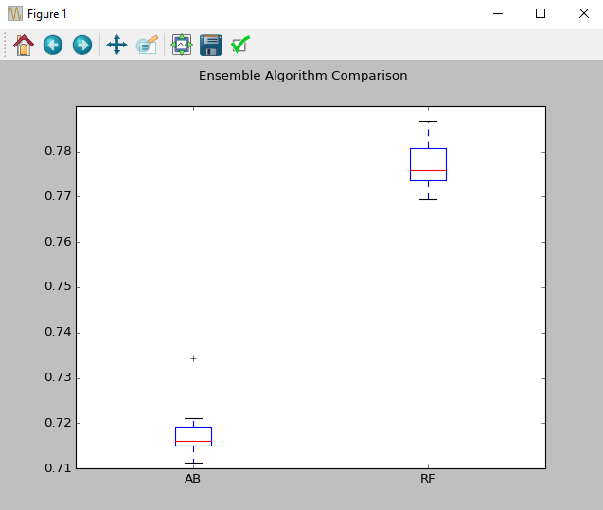
We found RF to be the best among the algorithms for the given data .So we validate the test data using KNN and got a classification rate of 0.777125.

Slide 35
Ensemble Methods
Another way that we can improve the performance of algorithms on this problem is by using
ensemble methods. In this section we will evaluate four different ensemble machine learning algorithms, two boosting and two bagging methods:
Boosting Methods: AdaBoost (AB) and Gradient Boosting (GBM).
Bagging Methods: Random Forests (RF) and Extra Trees (ET).

Slide 36
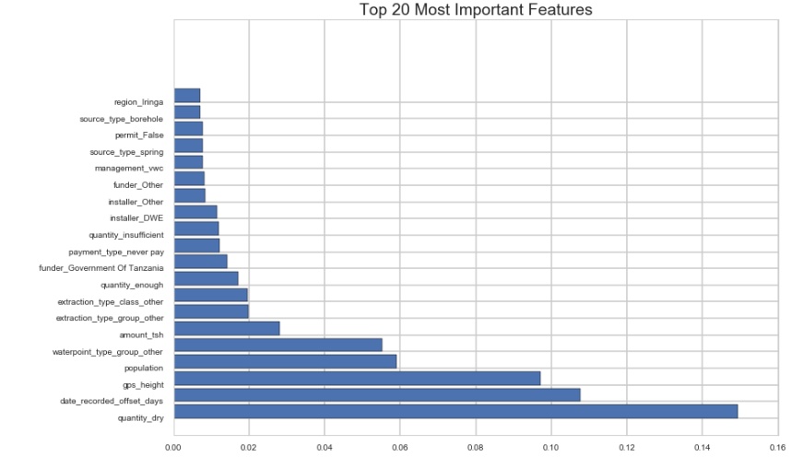
We again validate our earlier observation that the indicator for a dry quantity seems to be important in predicting well status. The indicators for the other quantity levels - enough and insufficient - also appear in our top 20 most important features

Slide 37
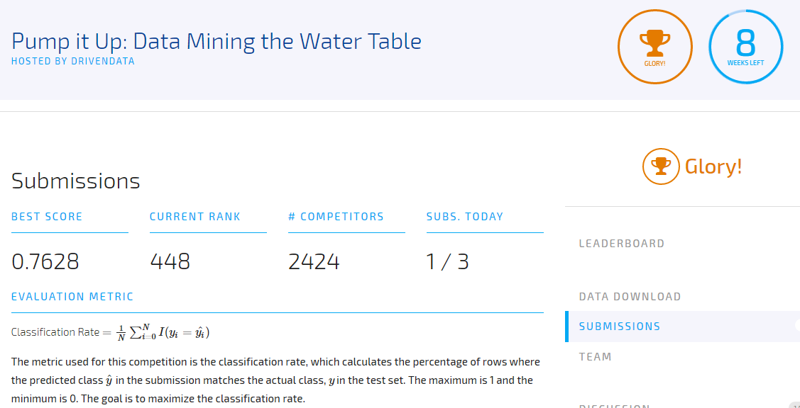
Initial Leader-board Rank:-

